Slide 1

Chapter 30
Internet
Security
Copyright © The McGraw-Hill Companies, Inc. Permission required for reproduction or display.

Slide 2
OBJECTIVES:
To introduce the idea of Internet security at the network layer and the IPSec protocol that implements that idea in two modes: transport and tunnel.
To discuss two protocols in IPSec, AH and ESP, and explain the security services each provide.
To introduce security association and its implementation in IPSec.
To introduce virtual private networks (VPN) as an application of IPSec in the tunnel mode.
To introduce the idea of Internet security at the transport layer and the SSL protocol that implements that idea

Slide 3
OBJECTIVES (continued):
To show how SSL creates six cryptographic secrets to be used by the client and the server.
To discuss four protocols used in SSL and how they are related to each other.
To introduce Internet security at the application level and two protocols, PGP and S/MIME, that implement that idea.
To show how PGP and S/MIME can provide confidentiality and message authentication.
To discuss firewalls and their applications in protecting a site from intruders.

Slide 4
Chapter
Outline
30.1 Network Layer Security
30.2 Transport Layer Security
30.3 Application Layer Security
30.4 Firewalls

Slide 5
30-1 NETWORK LAYER SECURITY
We start this chapter with the discussion of security at the network layer. Although in the next two sections we discuss security at the transport and application layers, we also need security at the network layer. IP Security (IPSec) is a collection of protocols designed by the Internet Engineering Task Force (IETF) to provide security for a packet at the network level. IPSec helps create authenticated and confidential packets for the IP layer.

Slide 6
Topics Discussed in the Section
Two Modes
Two Security Protocols
Services Provided by IPSec
Security Association
Internet Key Exchange (IKE)
Virtual Private Network (VPN)

Slide 7
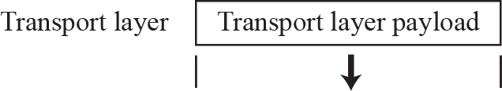
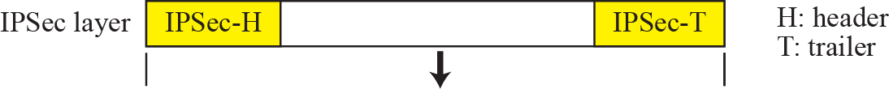
Figure 30.1 IPSec in transport mode

Slide 8

Note
IPSec in transport mode does not protect the IP header;
it only protects the information coming from the transport layer.

Slide 9
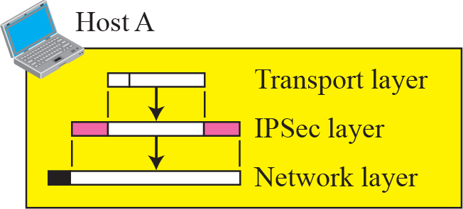
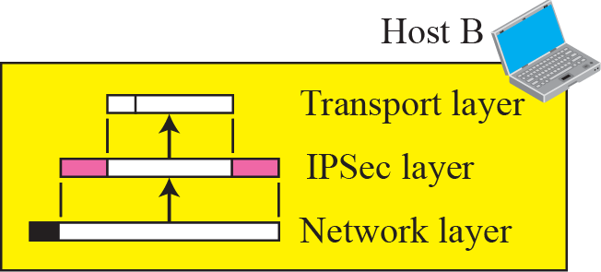
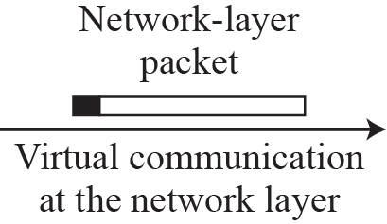
Figure 30.2 Transport mode in Action

Slide 10
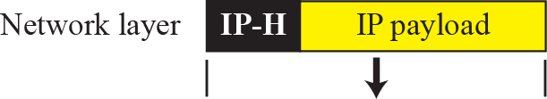
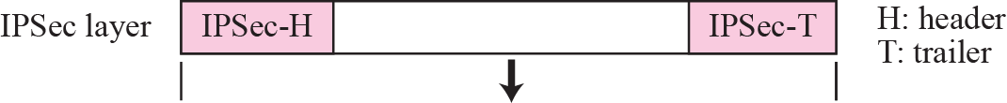
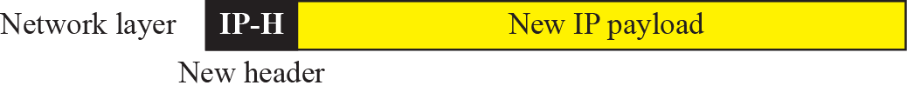
Figure 30.3 IPSec in tunnel mode

Slide 11
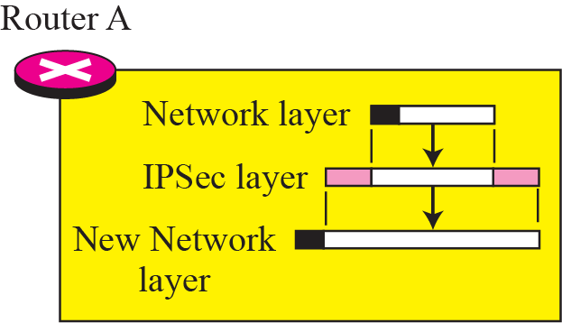
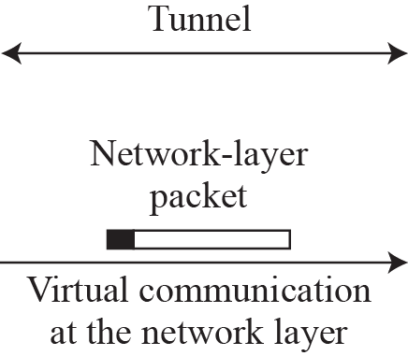
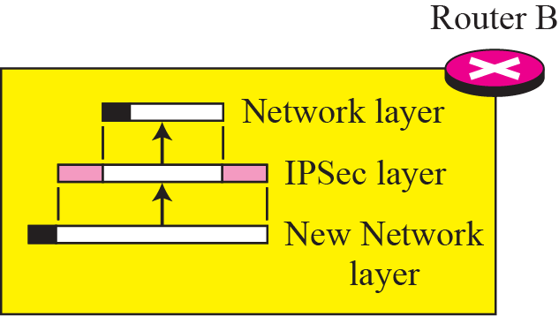
Figure 30.4 Tunnel-mode in action
Tunnel

Slide 12
Note
IPSec in tunnel mode protects the original IP header.

Slide 13
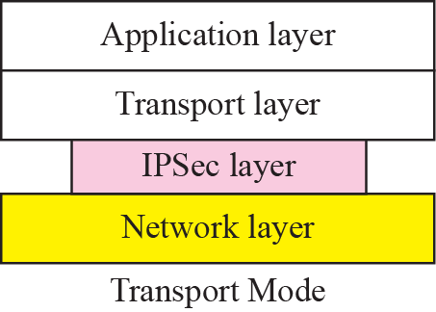
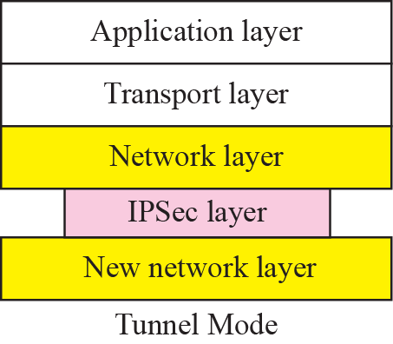
Figure 30.5 Transport mode versus tunnel mode

Slide 14
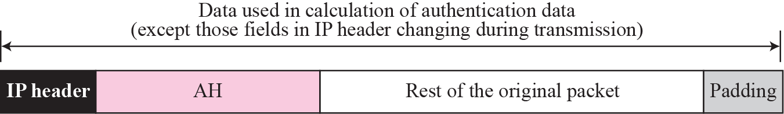
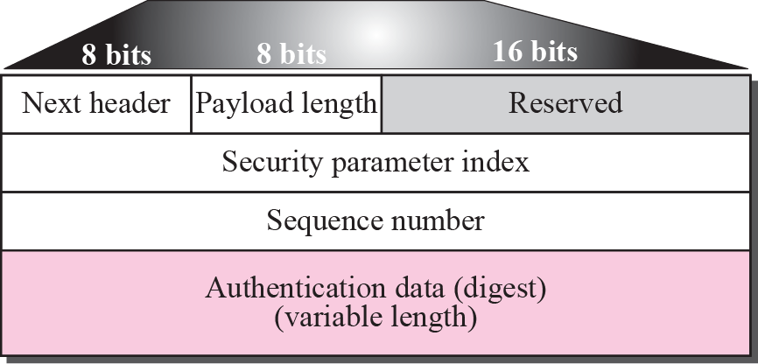
Figure 30.6 Authentication Header (AH) protocol

Slide 15
Note
The AH protocol provides source authentication and data integrity,
but not privacy.

Slide 16
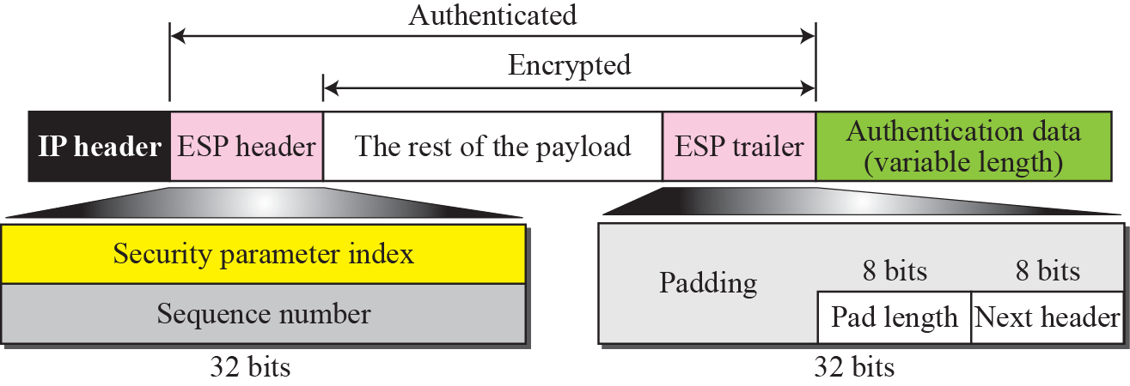
Figure 30.7 Encapsulating Security Payload (ESP)

Slide 17
Note
ESP provides source authentication, data integrity, and privacy.

Slide 18
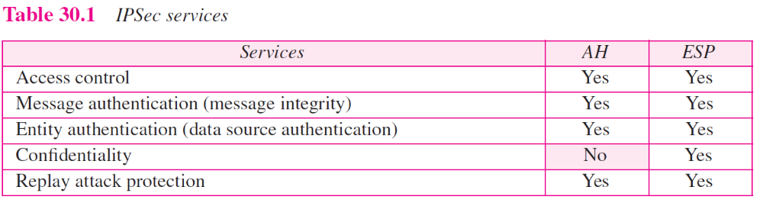

Slide 19
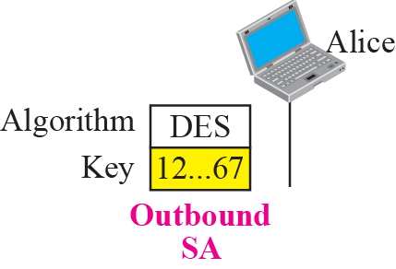
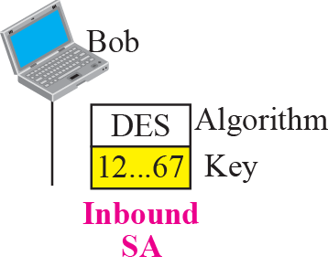
Figure 30.8 Simple SA

Slide 20
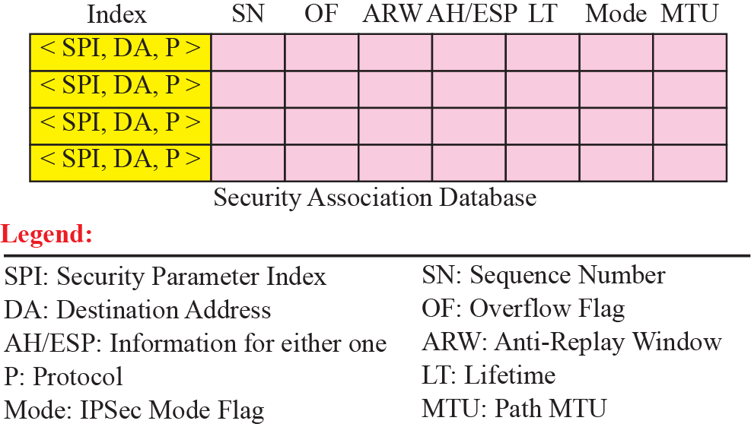
Figure 30.9 SAD

Slide 21
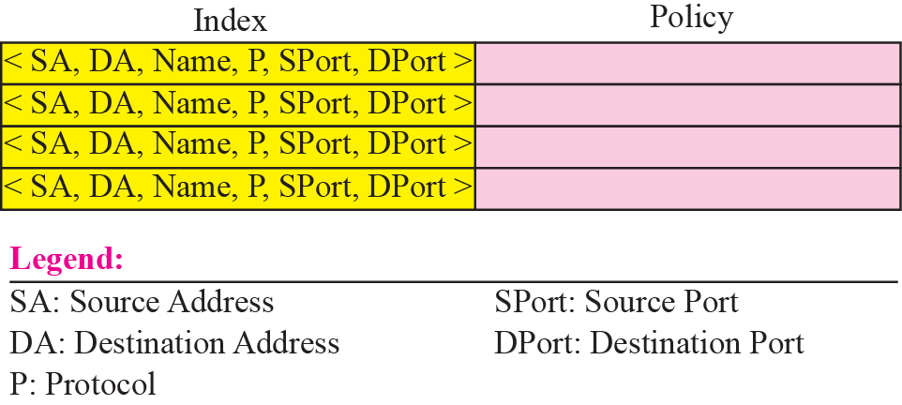
Figure 30.10 SPD

Slide 22
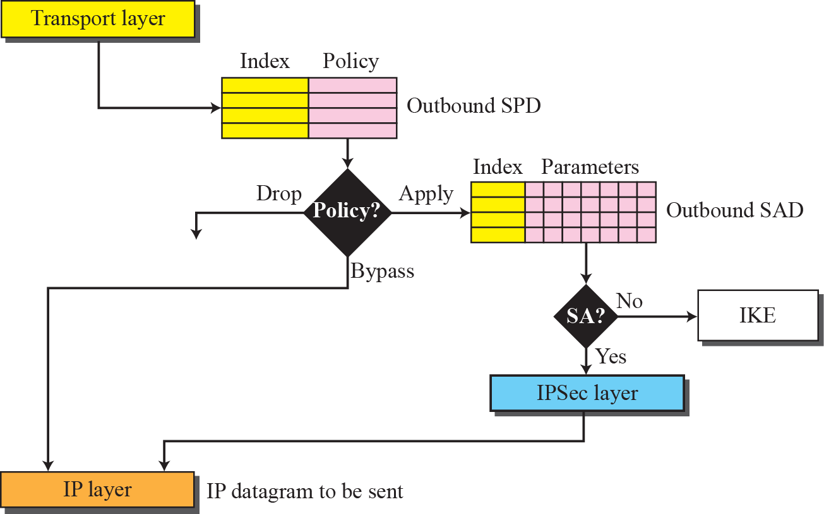
Figure 30.11 Outbound processing

Slide 23
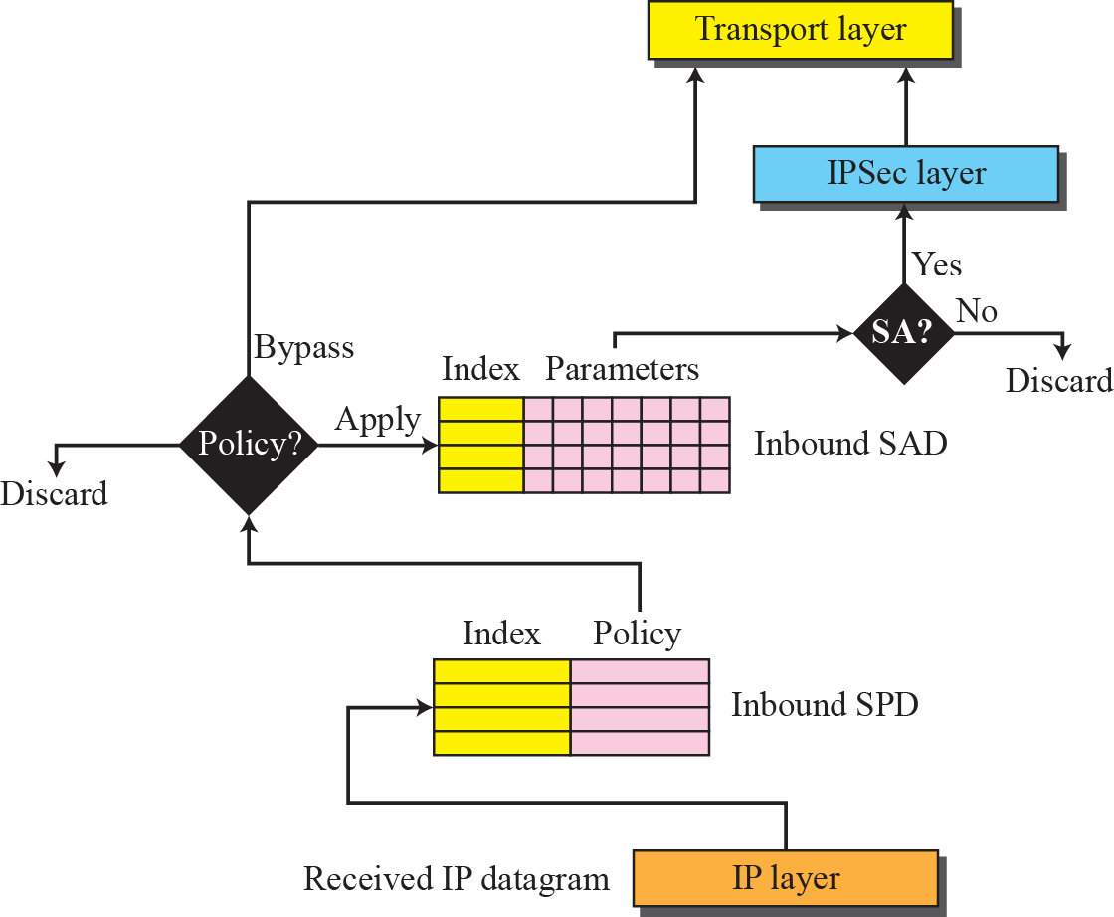
Figure 30.12 Inbound processing

Slide 24
Note
IKE creates SAs for IPSec.

Slide 25
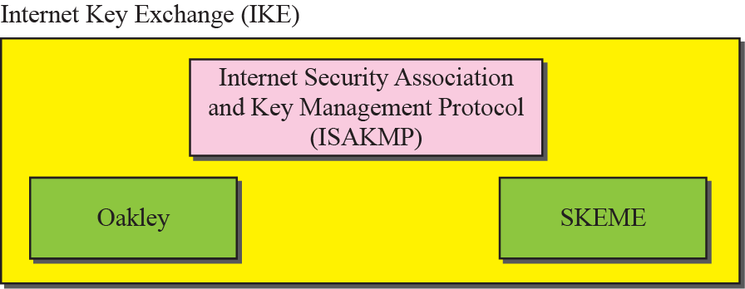
Figure 30.13 IKE components

Slide 26
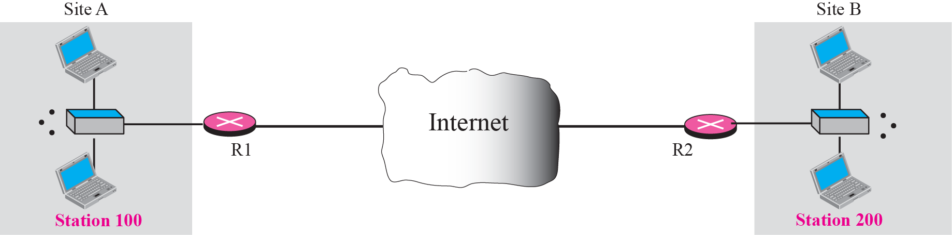
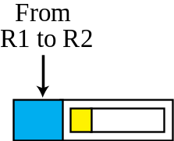
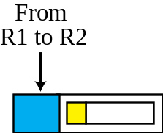
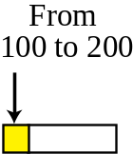
Figure 30.14 Virtual private network

Slide 27
30-2 TRANSPORT LAYER SECURITY
Two protocols are dominant today for providing security at the transport layer: the Secure Sockets Layer (SSL) protocol and the Transport Layer Security (TLS) protocol. The latter is actually an IETF version of the former. We discuss SSL in this section; TLS is very similar. Figure 30.15 shows the position of SSL and TLS in the Internet model.

Slide 28
Topics Discussed in the Section
SSL Architecture
Four Protocols

Slide 29
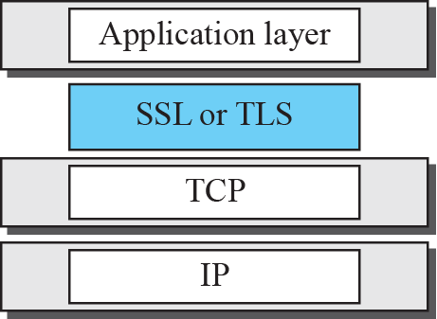
Figure 30.15 Location of SSL and TSL in the Internet mode

Slide 30
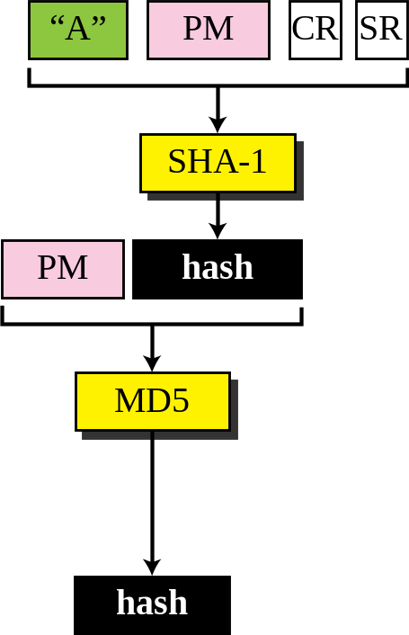
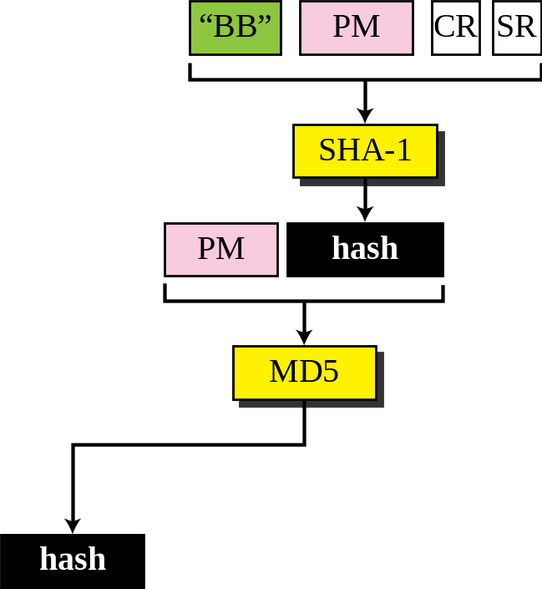
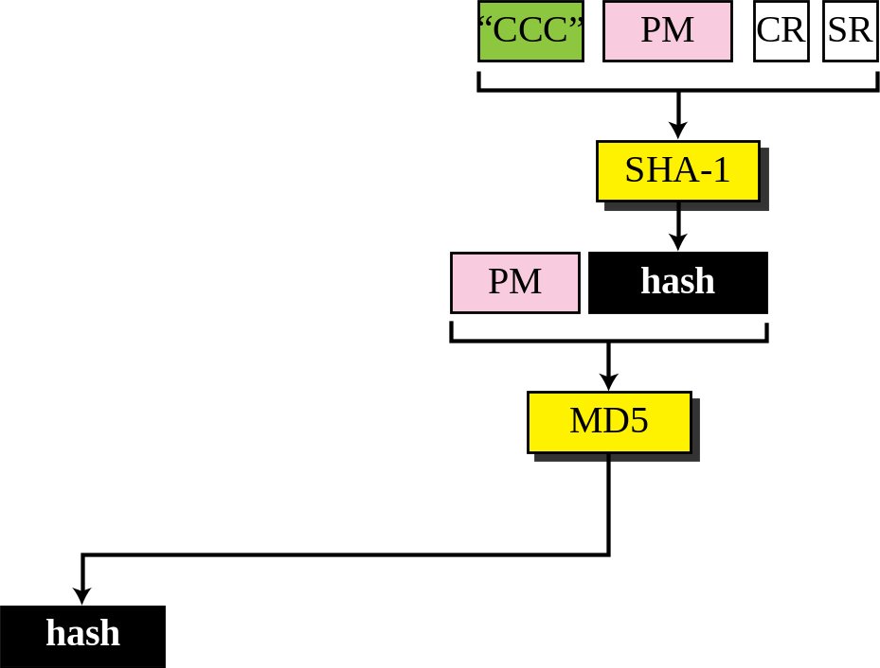
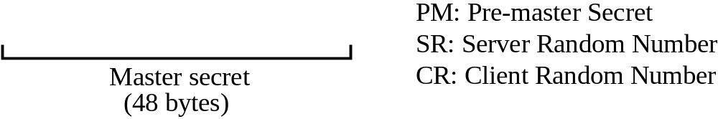
Figure 30.16 Calculation of maser key from pre-master secret

Slide 31
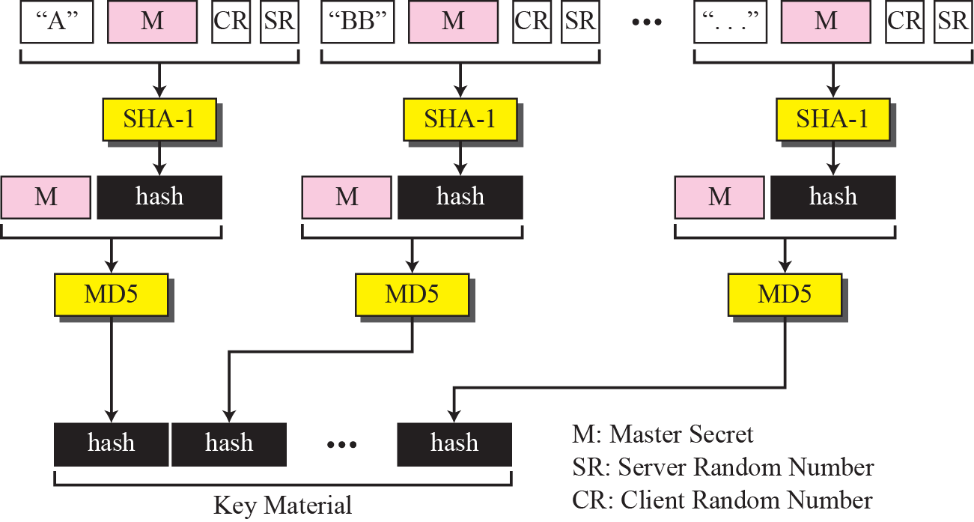
Figure 30.17 Calculation of the key materials from master secret

Slide 32
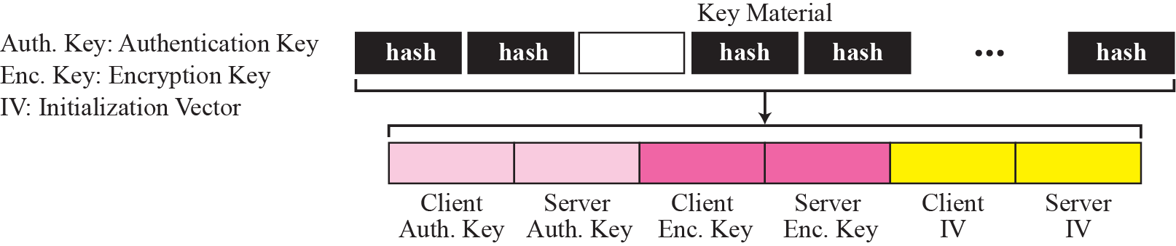
Figure 30.18 Extraction of cryptographic secrets from key materials

Slide 33
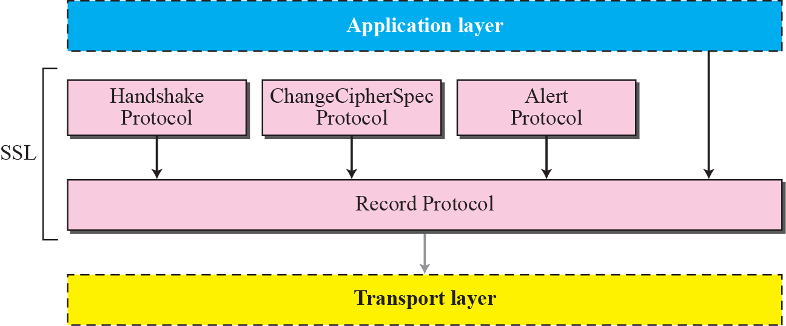
Figure 30.19 Four SSL protocols

Slide 34
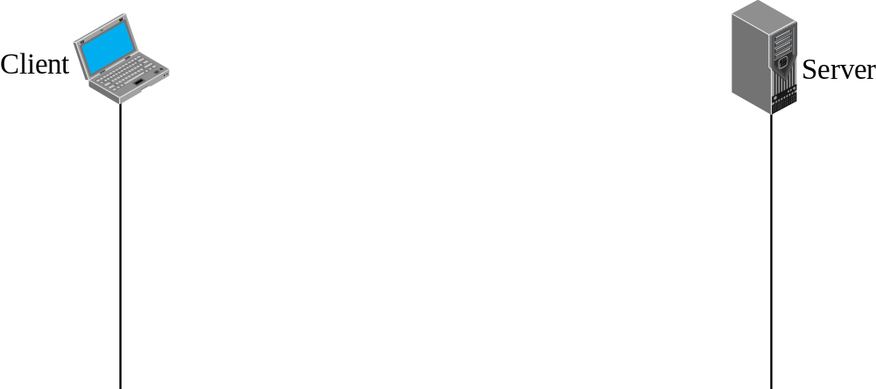
Figure 30.20 Handshake protocol

Slide 35
Note
After Phase I, the client and server know the version of SSL, the cryptographic algorithms, the compression method, and the two random numbers for key generation.

Slide 36
Note
After Phase II, the server is authenticated to the client, and
the client knows the public
key of the server if required.

Slide 37
Note
After Phase III, The client is authenticated for the serve, and
both the client and the server
know the pre-master secret.

Slide 38
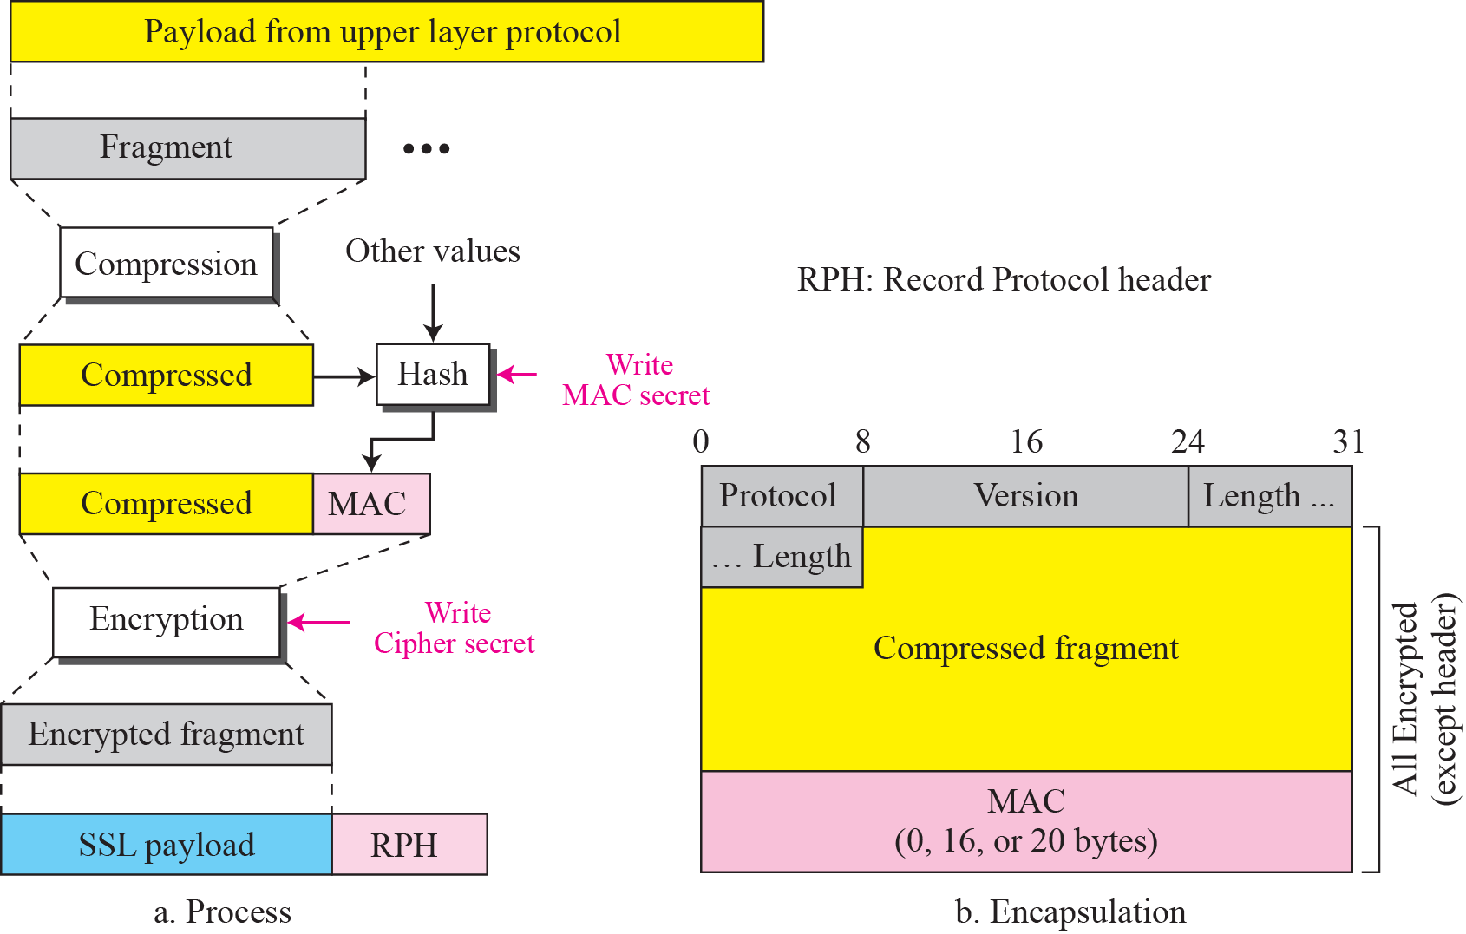
Figure 30.21 Processing done by the record protocol

Slide 39
30-3 APPLICATION LAYER SECURITY
This section discusses two protocols providing security services for e-mails: Pretty Good Privacy (PGP) and Secure/Multipurpose Internet Mail Extension (S/MIME).

Slide 40
Topics Discussed in the Section
E-mail Security
Pretty Good Privacy (PGP)
Key Rings
PGP Certificates
S/MIME
Applications of S/MIME

Slide 41
Note
In e-mail security, the sender of the message needs to include the name
or identifiers of the algorithms
used in the message.

Slide 42
Note
In e-mail security, the encryption/decryption is done using a symmetric-key algorithm, but the secret key to decrypt the message is
encrypted with the public key of the
receiver and is sent with the message.

Slide 43
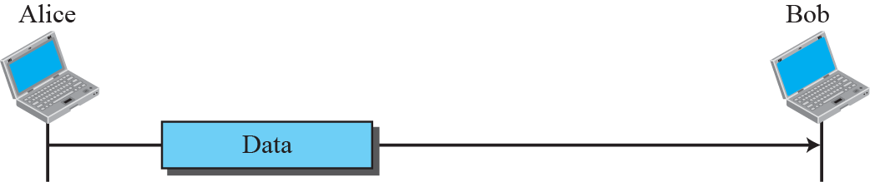
Figure 30.22 A plaintext message

Slide 44
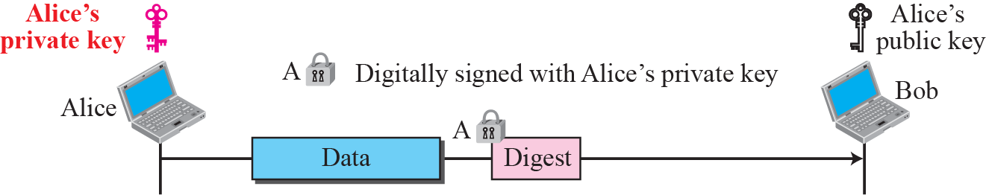
Figure 30.23 An authenticated message

Slide 45
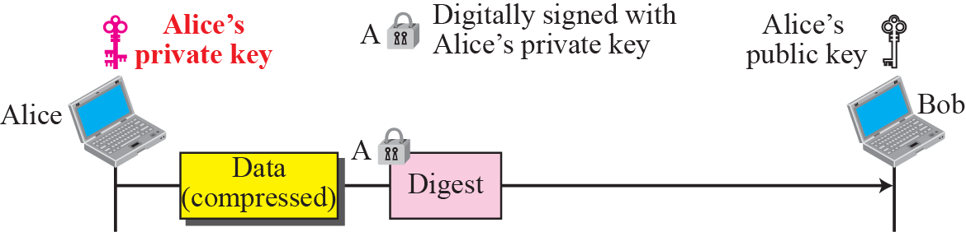
Figure 30.24 A compressed message

Slide 46
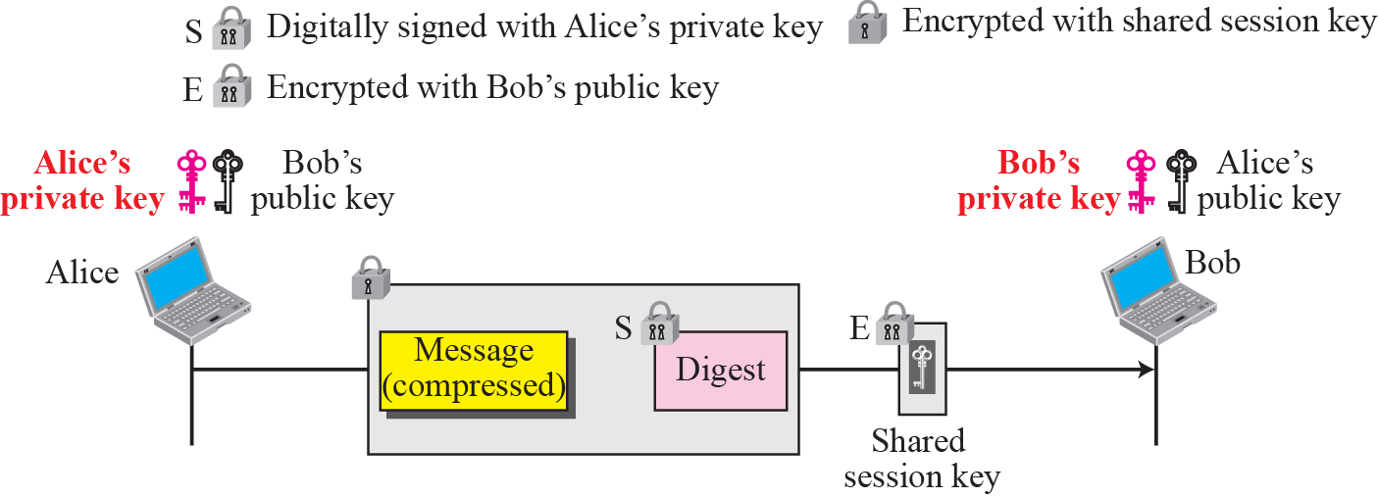
Figure 30.25 A confidential message

Slide 47
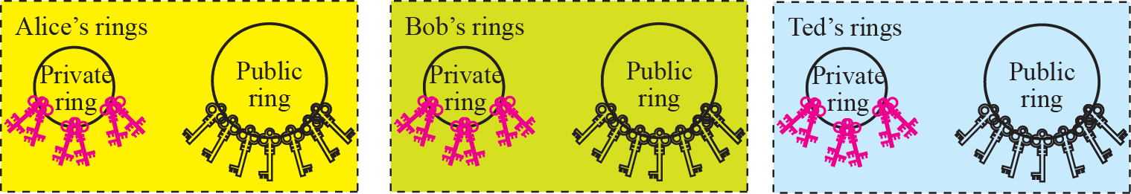
Figure 30.26 Key rings in PGP

Slide 48
Note
In PGP, there can be multiple paths from fully or partially trusted authorities
to any subject.

Slide 49
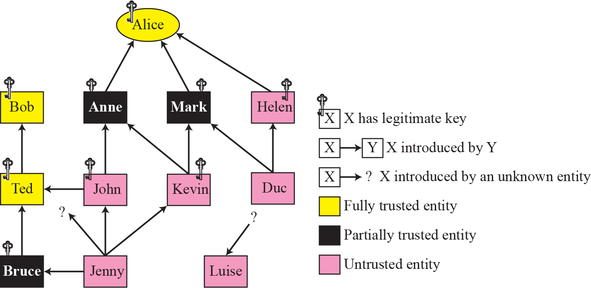
Figure 30.27 Trust model

Slide 50
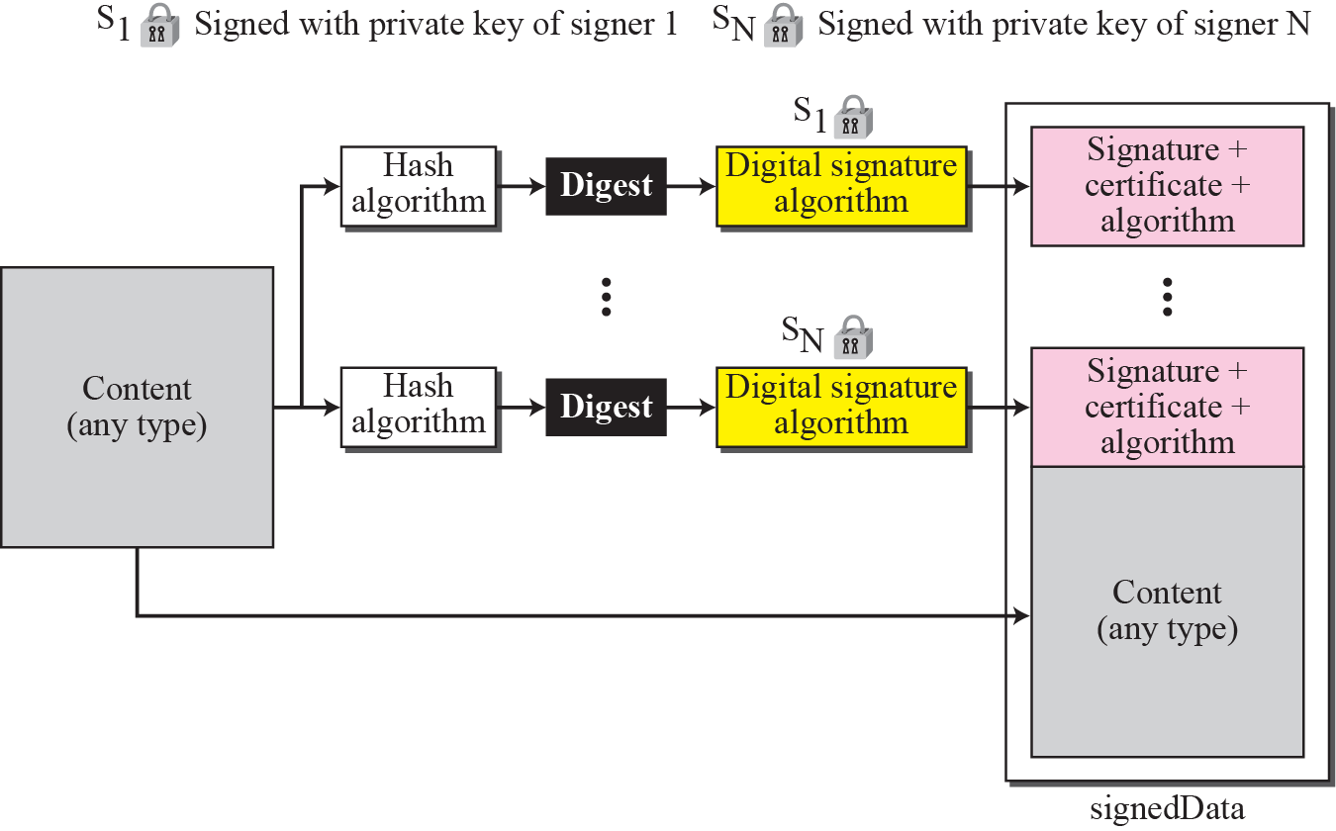
Figure 30.28 Signed-data content type

Slide 51
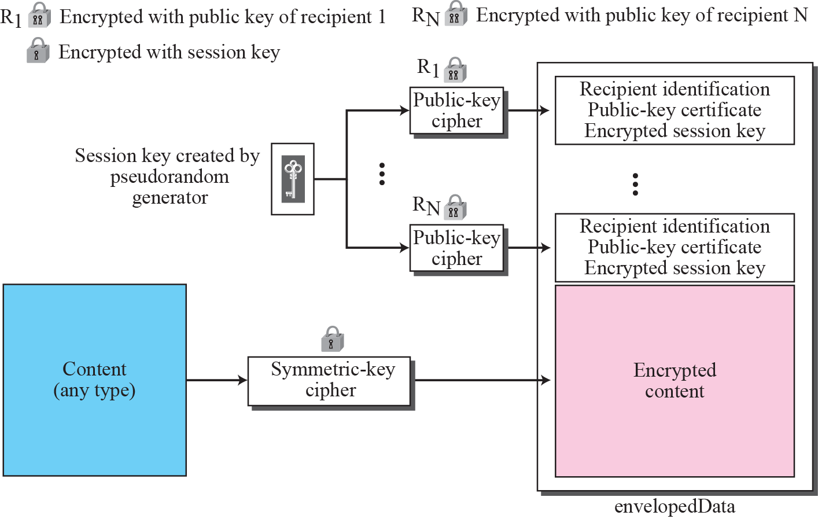
Figure 30.29 Encrypted-data content type

Slide 52
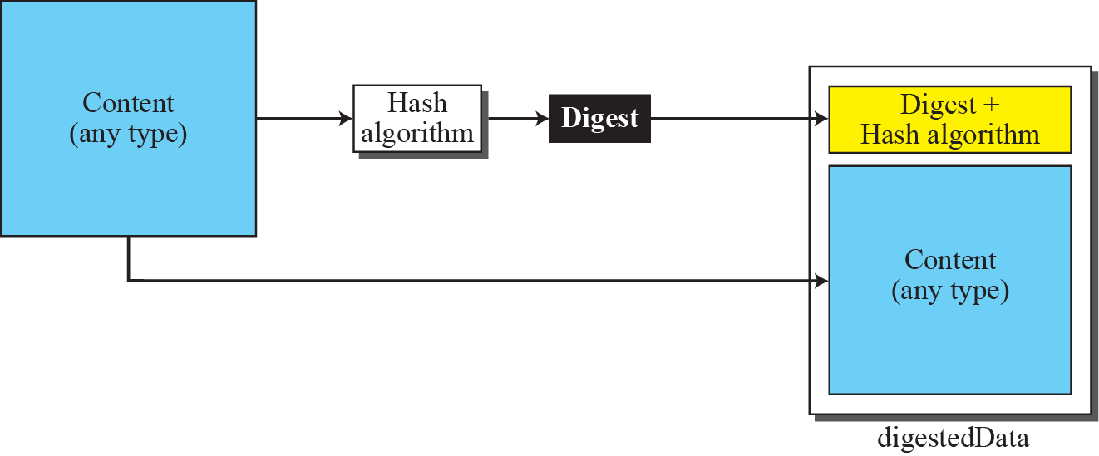
Figure 30.30 Digest-data content type

Slide 53
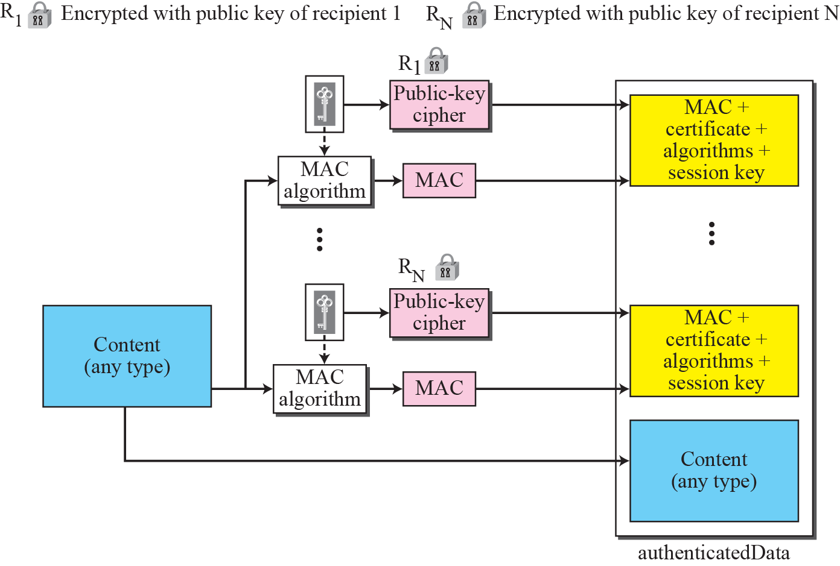
Figure 30.31 Authenticated-data content type

Slide 54
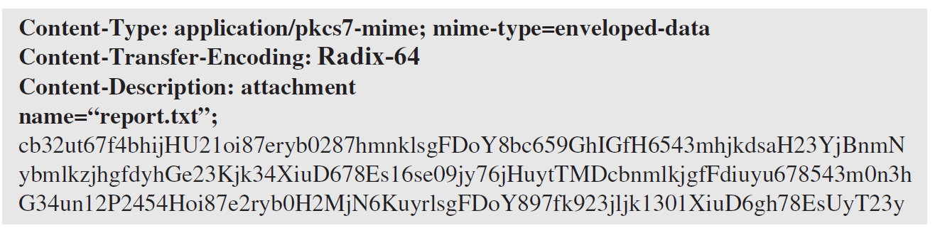
Example 30.1
The following shows an example of an enveloped-data in which a small message is encrypted using triple DES.

Slide 55
30-4 FIREWALLS
All previous security measures cannot prevent Eve from sending a harmful message to a system. To control access to a system we need firewalls. A firewall is a device (usually a router or a computer) installed between the internal network of an organization and the rest of the Internet. It is designed to forward some packets and filter (not forward) others. Figure 30.32 shows a firewall.

Slide 56
Topics Discussed in the Section
Packet-Filter Firewall
Proxy Firewall

Slide 57
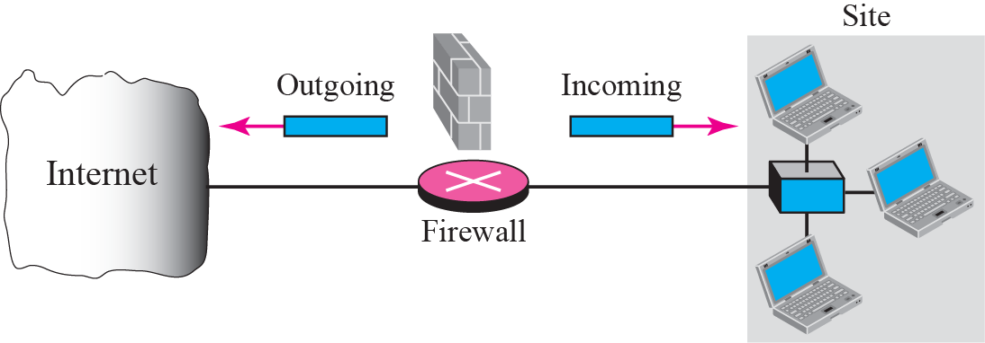
Figure 30.32 Firewall

Slide 58

Figure 30.33 Packet-filter firewall

Slide 59
Note
In PGP, there can be multiple paths from fully or partially trusted authorities
to any subject.

Slide 60




Figure 30.34 Proxy firewall

Slide 61
Note
A proxy firewall filters at the
application layer.

